Slide 1
NHL All-Star Game Selection
DTSA 5509 Final Project

Slide 2

Table of Contents
Motivation
Data Sources
Cleaning
EDA
Modeling
Analysis
Conclusion
Image: sportingnews.com

Slide 3

Motivation
NHL hockey players are the best in the world, what makes one player stand out even more among such elite talent?
Using past seasons worth of player game statistics, can we predict selection to an All-Star Game?
What aspects of play contribute most to selection?
Does one particular aspect of the game, i.e. power plays, contribute more than other areas?
Image: NHL.com

Slide 4
Data Sources
Data pulled from two primary sources
MoneyPuck.com
Player statistics from 2019-2024
Wikipedia
NHL All-Star Game Rosters from 2019 - 2024
MoneyPuck Data
Column Type | Number of Columns
String/Categorical | 3
Integer | 4
Float | 147
Total Rows | 23,370

Slide 5
Cleaning
Statistics Data Frame
Removed 2021 data
No All-Star Game that year
Altered players’ names for merging
Removed players not playing in enough games
Removed unnecessary or derivative features
Some features built on calculations of other features
Pivoted power play data to new columns
Target Data Frame
Removed goalies
No goalie data in skaters data sets
Altered players’ names for merging

Slide 6
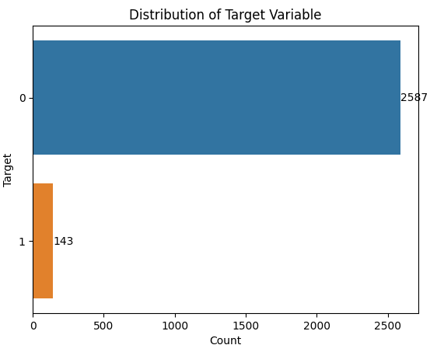
EDA
Examine target class distribution
Imbalanced, about 5% of rows in positive target class
Searched for multicollinearity of features
Used pair plots from within game type class
Subset of even-strength, power play, and penalty kill features only compared within those classes

Slide 7
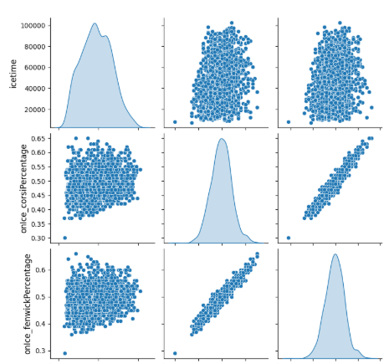
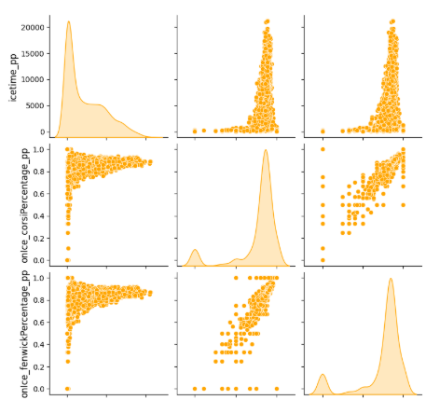
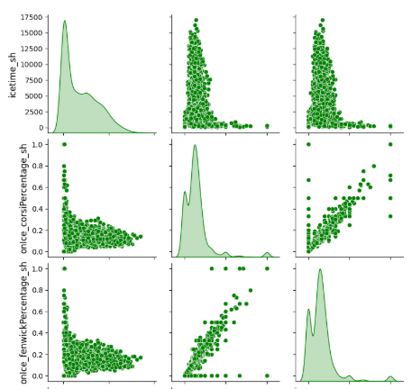
EDA Continued
Even Strength
Power Play
Short Handed

Slide 8
Modeling
After cleaning I fit three classification models; XGBoost, Random Forest, Lasso Regression
Chose these models to do classification
These models also have good ability to extract feature importance
After discovering collinearity, removed features to avoid problems in the models before fitting
Removed variables for Fenwick Percentage, shot attempts, and giveaways, among others
Used GridSearchCV for hyperparameter search
Selected hyperparameters based on best mean ROC-AUC

Slide 9
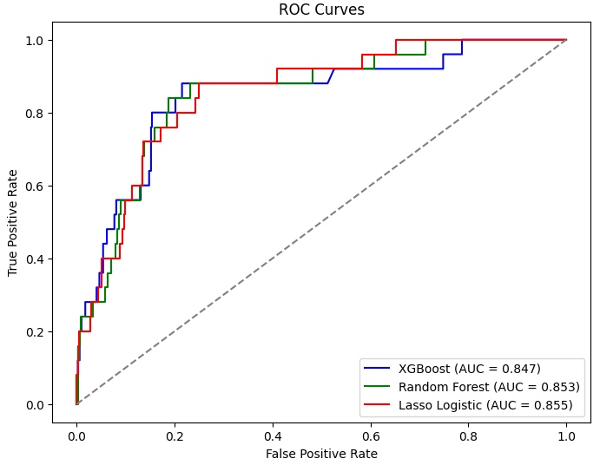
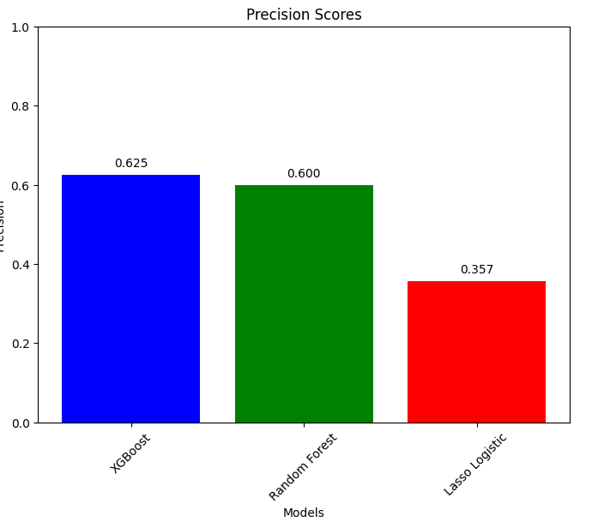
Modeling Continued
XGBoost
Good ROC-AUC
Best Precision
Random Forest
Good ROC-AUC
Unreliable Precision
Lasso Regression
Good ROC-AUC
Bad Precision

Slide 10
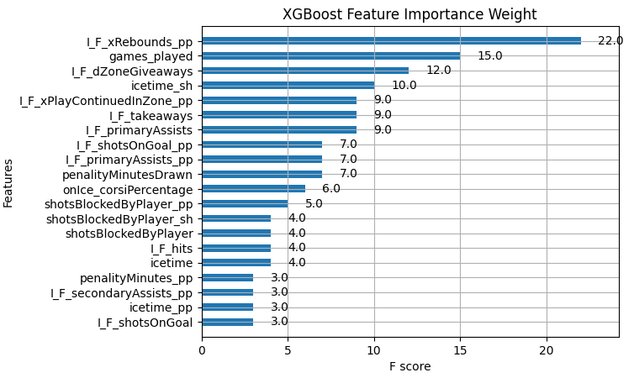
Analysis
The models did a poor job of predicting the positive class
Models assigned probabilities just over 0.5 for positive predictions
Lasso had greater prediction confidence but this led to many for false positives evidenced by the poor precision results
Still gained important information about feature importance
Because ROC is probability value agnostic, we could still see what features the tree models identified as important

Slide 11
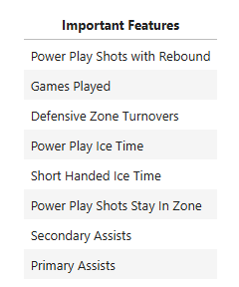
Conclusion
Findings
Models performance underwhelmed particularly in regard to precision. Still found valuable feature importance insights
Recommendations
To make the All-Star Team
Get time on special teams
Avoid defensive turnovers
Accumulate assists and shots generating rebounds
Future Work
Explore interactions between player position and statistics
Explore on-ice and off-ice splits

